Slide 1
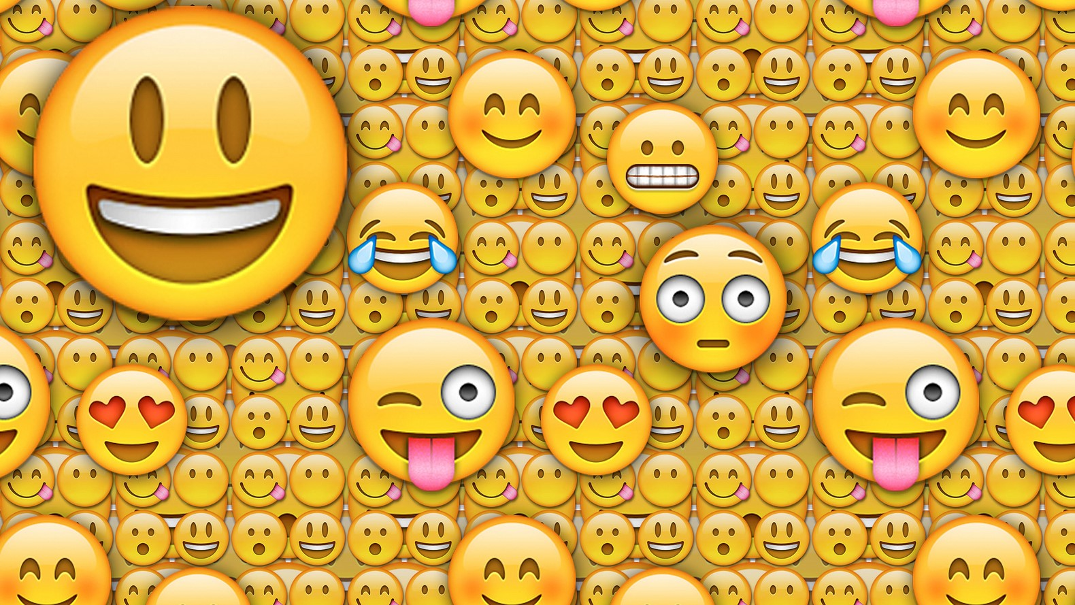

Slide 2
Sentiment of Emojis
Petra Novak, Jasmina Smailović, Borut Sluban, Igor Mozetič
Joel Ellery Baines

Slide 3

Definitions
Emoticon - shorthand for a facial expression ;-)
Emoji - emojis are unicode graphic symbols used as a shorthand to express concepts and ideas. A graphic symbol, ideogram, that represents not only facial expressions, but also concepts and ideas, such as celebration, weather, vehicles and buildings, food and drink, animals and plants, or emotions, feelings, and activities.
Sentiment Analysis - the field of study that analyzes people’s opinions, sentiments, evaluations, attitudes, and emotions from a text
Notes:
First used by prof scott fahlman sept 19, 1982 @ carnegie mellon university :-) & :-( used to distinguish serious posts from jokes
Etymology - “picture character” in japanese e (picture) + moji (character)

Slide 4
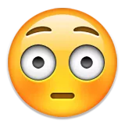
Data & Process
Data pool of 1.6 million tweets
13 languages
Labeled by 83 native speakers
Sentiment labels are discrete 3 valued variable {-1, 0, +1}, {negativity, neutral, positive}
An emoji can be counted multiple times within a single tweet
Occurrences must be N ≥ 5, otherwise excluded
Created sentiment lexicon for 751 most frequently used emojis

Slide 5

What did they want to find out?
Are the tweets with emojis more emotionally loaded?
Does the presence of emojis in tweets have an impact on the human emotional perception of the tweets?
Where are the emojis typically placed in tweets?
Is the sentiment ranking between the different languages significantly different?

Slide 6
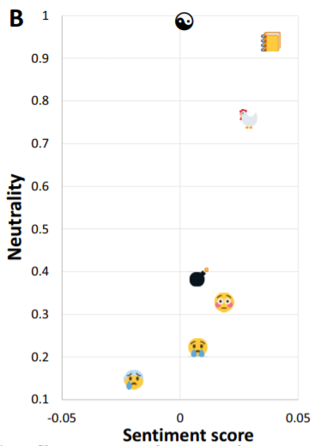
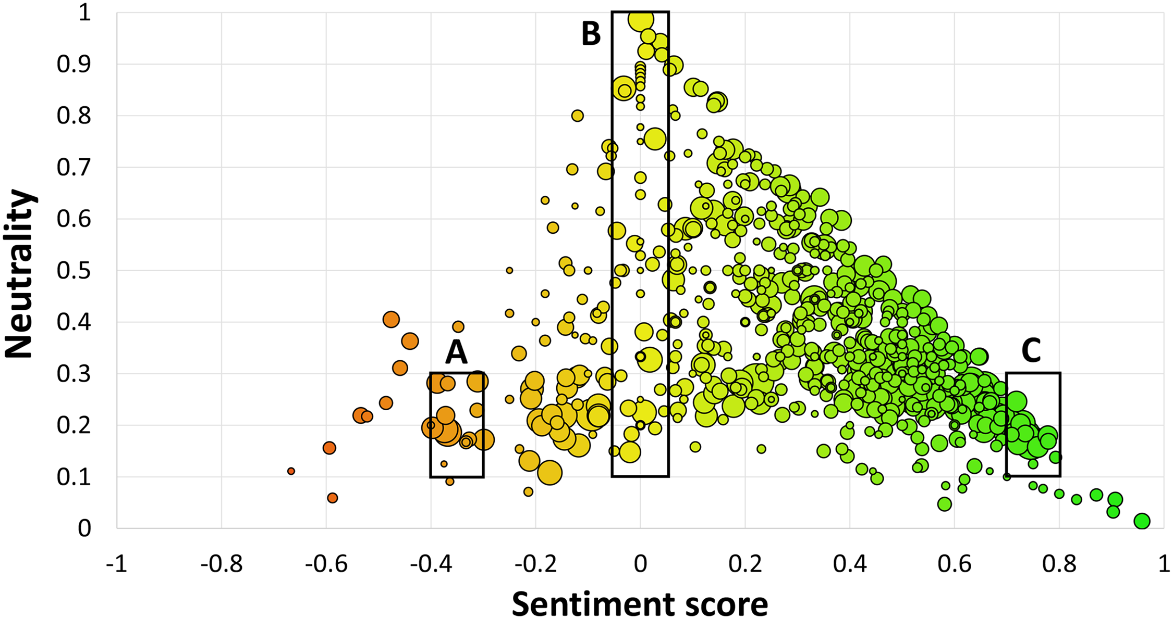
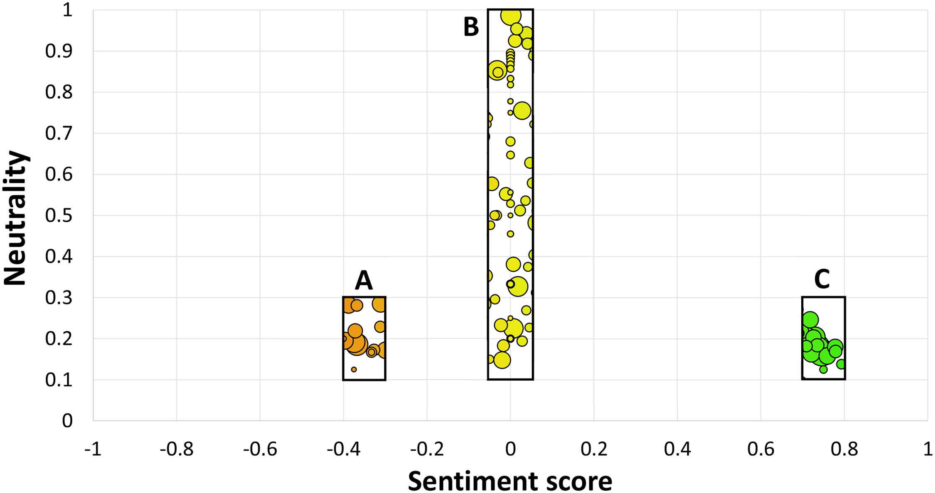
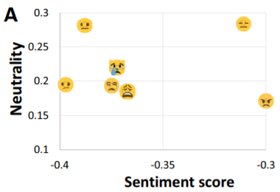
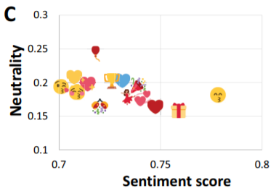
Emoji sentiment scores

Slide 7
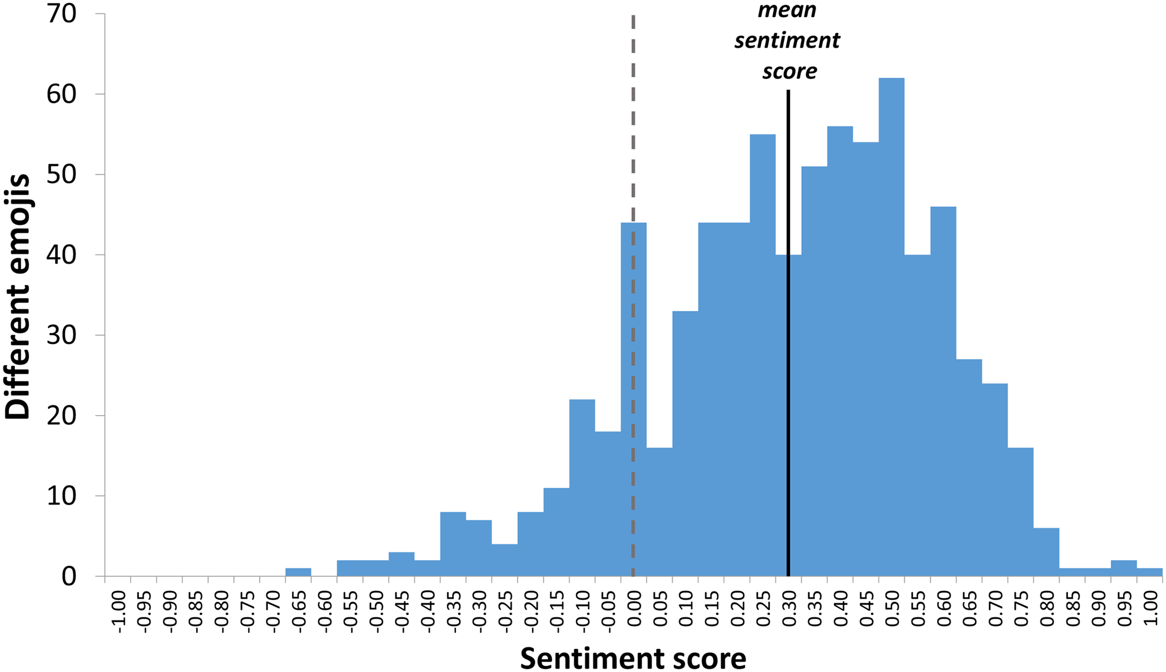
Distribution of sentiment scores

Slide 8
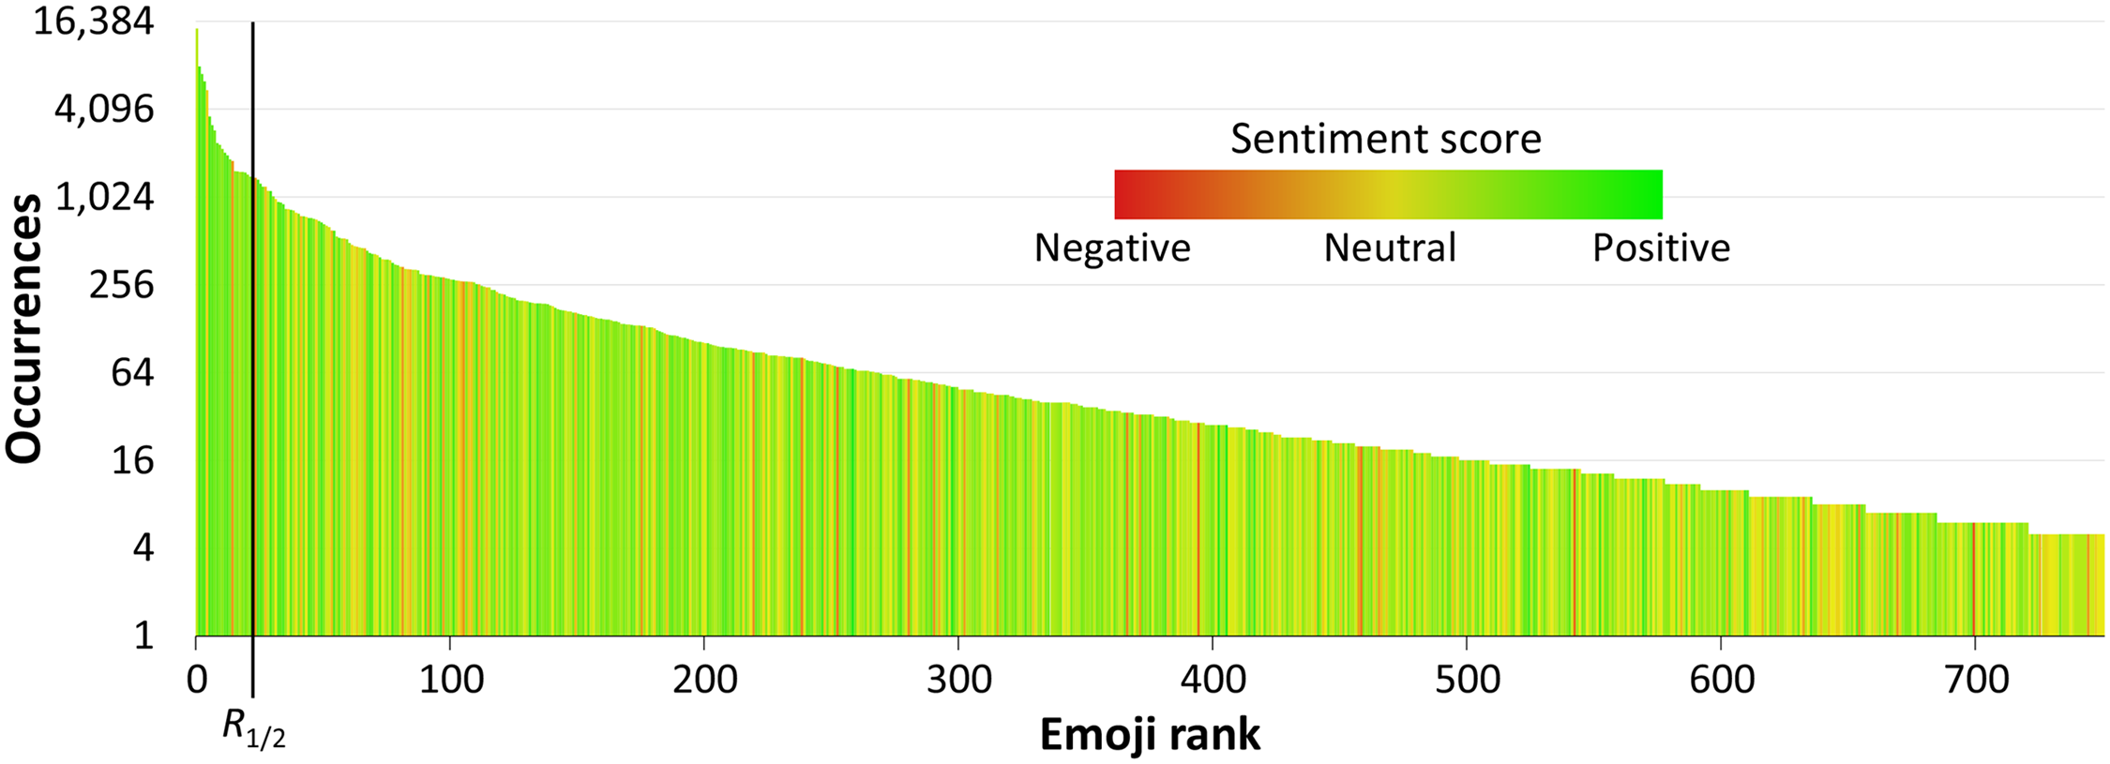
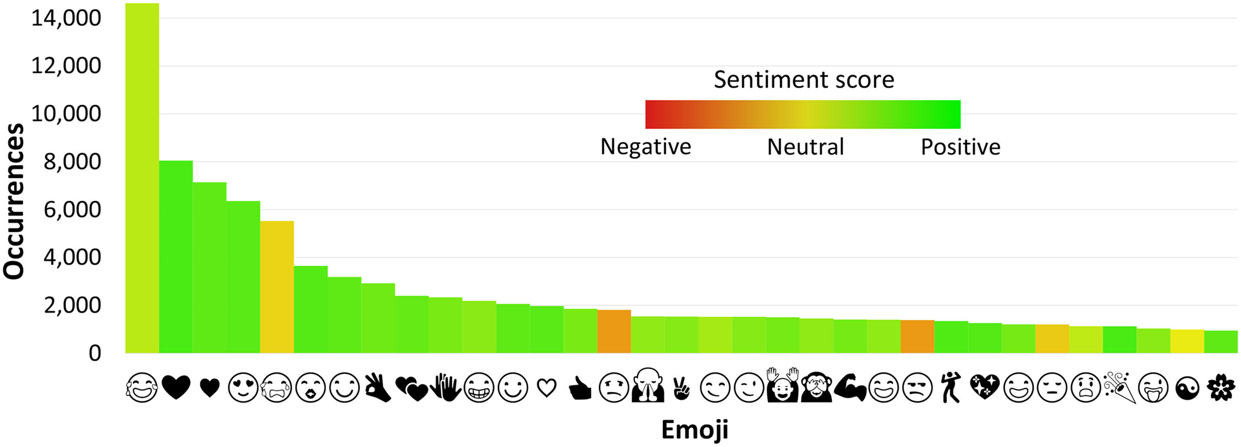
Top 751
Top 33

Slide 9
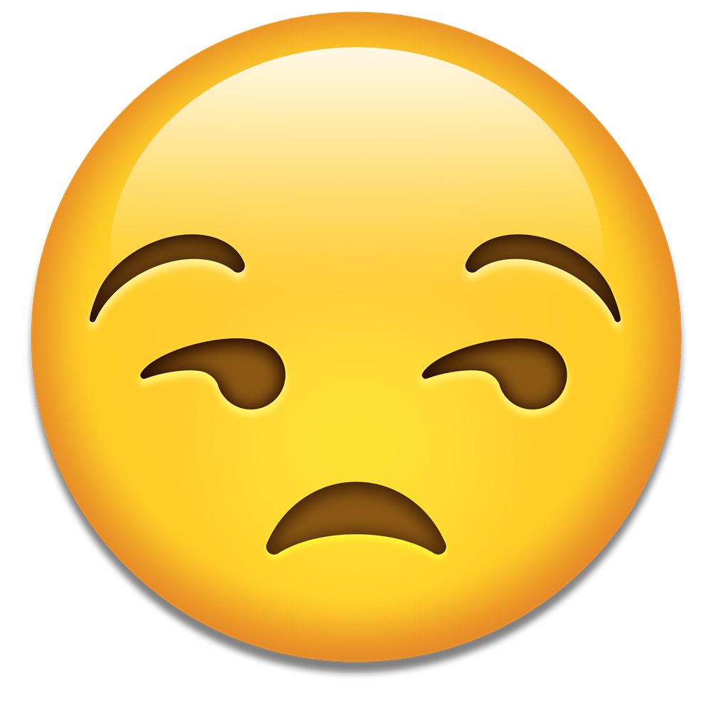
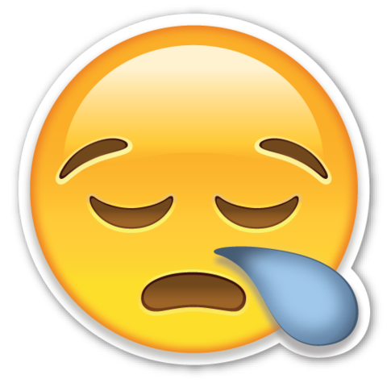
Checks
Compared against Emojitracker, a real time website that monitors emojis use on twitter
Annotators are sometimes not consistent (even with themselves), must measure inter-annotator agreement. Double checked by redundancy in tweet inspections, and the following metrics...
Krippendorff’s Alpha-reliability score, where a disagreement between the negative and the positive sentiment is four times as costly as that between the neutral and positive
Accuracy - the number of equally labeled tweets by different annotators, divided by the total number of tweets labeled twice
Machine learning model against a test set

Slide 10
What did they want to find out?
Are the tweets with emojis more emotionally loaded?
Does the presence of emojis in tweets have an impact on the human emotional perception of the tweets?
Where are the emojis typically placed in tweets?
Is the sentiment ranking between the different languages significantly different?
Are the tweets with emojis more emotionally loaded? Positive (yes-ish)
Does the presence of emojis in tweets have an impact on the human emotional perception of the tweets? 10% more accuracy
Where are the emojis typically placed in tweets?
Is the sentiment ranking between the different languages significantly different?

Slide 11
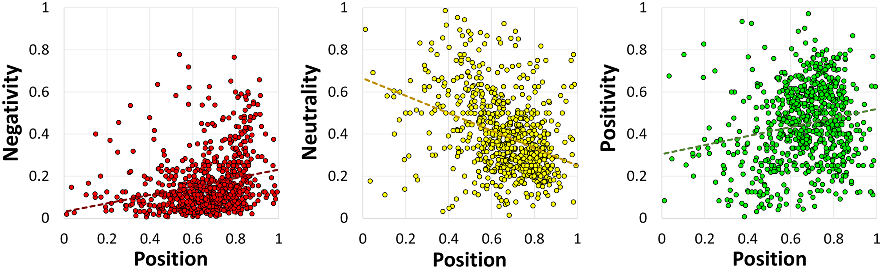
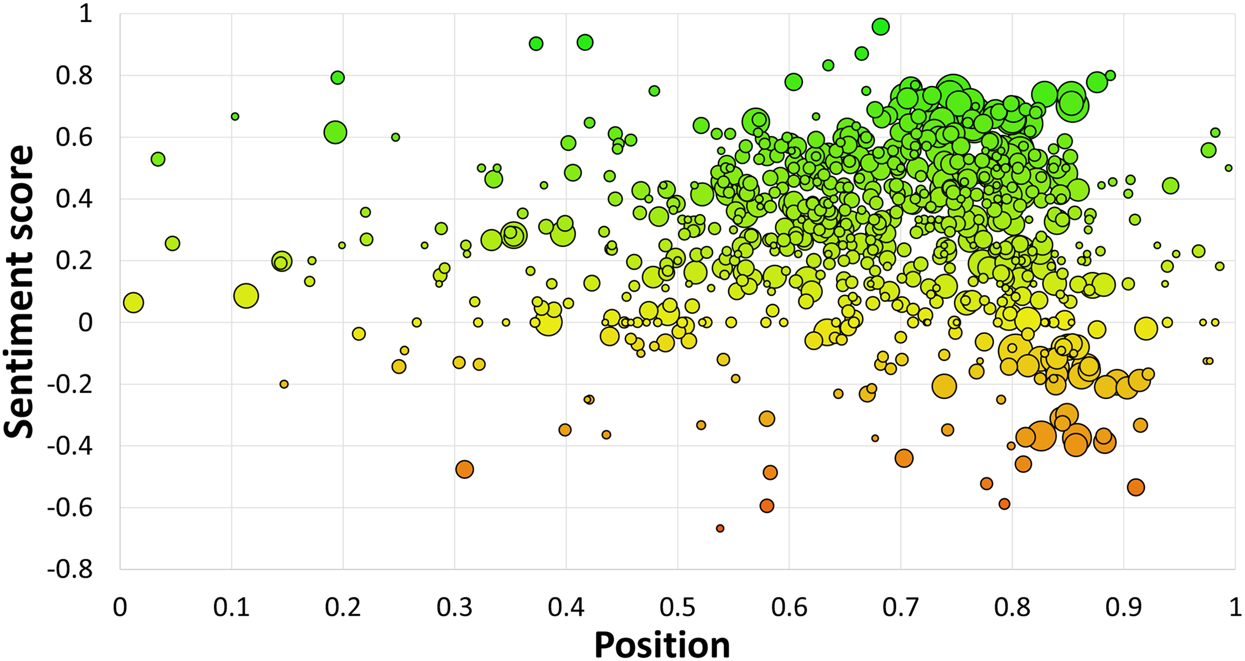
Where are emojis placed?
BEGINNING
MIDDLE
END
“…more emotionally loaded emojis, either negative or positive, tend to occur toward the end of the tweets.”
Notes:
Emoji is placed on average at 2/3rds of the length of the tweet

Slide 12
What did they want to find out?
Are the tweets with emojis more emotionally loaded? Positive (yes-ish)
Does the presence of emojis in tweets have an impact on the human emotional perception of the tweets? 10% more accuracy
Where are the emojis typically placed in tweets?
Is the sentiment ranking between the different languages significantly different?
Are the tweets with emojis more emotionally loaded?
Does the presence of emojis in tweets have an impact on the human emotional perception of the tweets?
Where are the emojis typically placed in tweets?
Is the sentiment ranking between the different languages significantly different?
Are the tweets with emojis more emotionally loaded? Positive (yes-ish)
Does the presence of emojis in tweets have an impact on the human emotional perception of the tweets? 10% more accuracy
Where are the emojis typically placed in tweets? 2/3 of the length
Is the sentiment ranking between the different languages significantly different?
“No evidence of significant differences between the languages”

Slide 13

Related Work
Stock reactions to twitter sentiment
National mood monitor for elections
Community analysis of environmental topics
Bitmoji / Memoji / Animoji
Fusing audio, visual and textual clues for sentiment analysis
Unicode 11.0

Slide 14


Thoughts
Harder but more interesting results from multi/cross lingual
Well thought out design
More data
Small annotator pool
Source data
Rankings ~ http://kt.ijs.si/data/Emoji_sentiment_ranking/
CSV ~ https://www.clarin.si/repository/xmlui/handle/11356/1048#

Slide 15
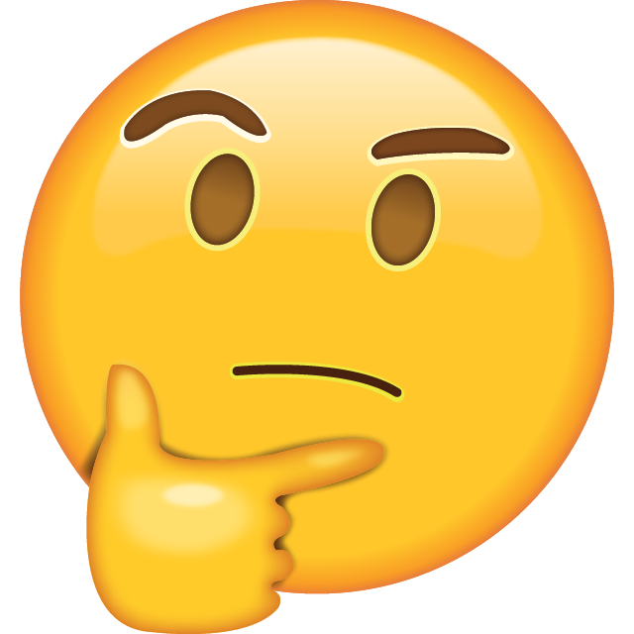
Questions?

Slide 17
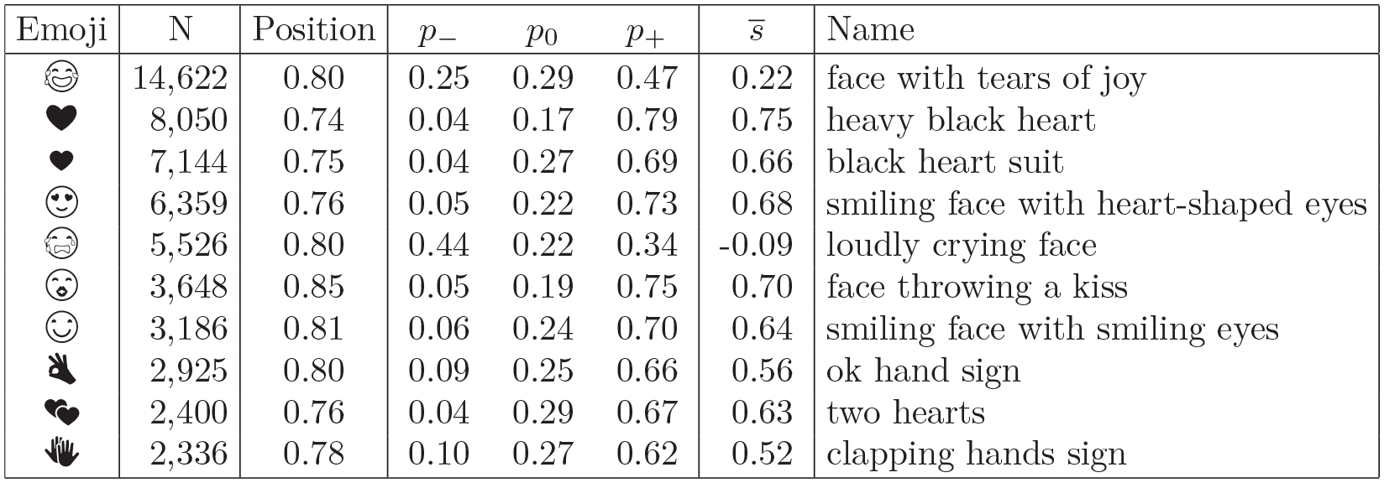
Top 10 emojis

Slide 18
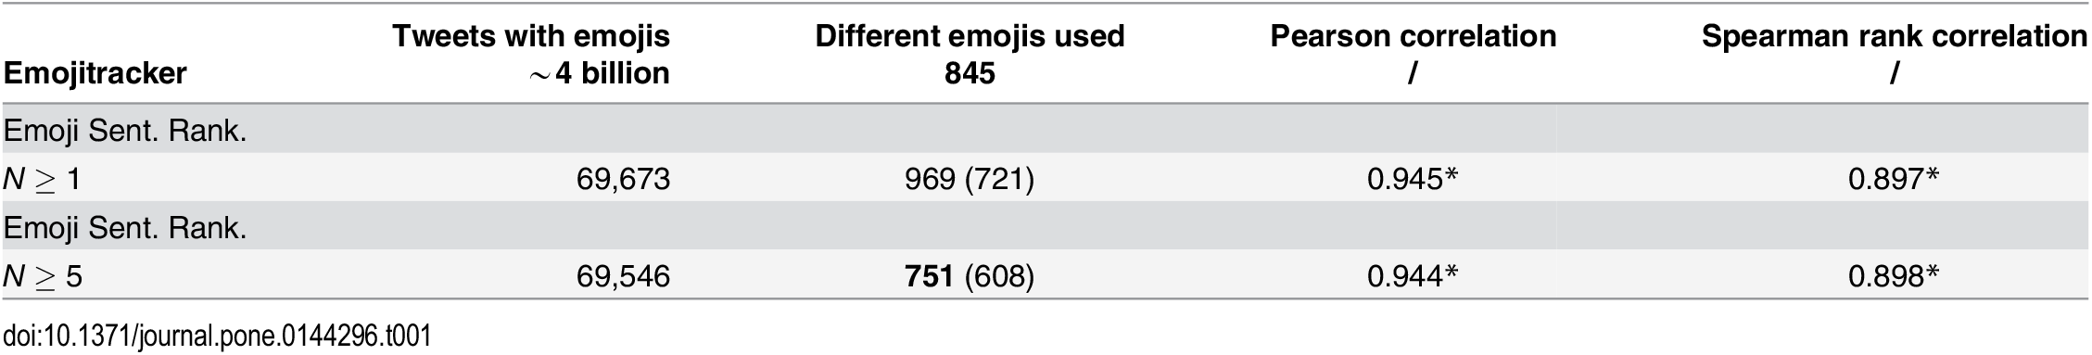
EmojiTracker Comparison

Slide 19
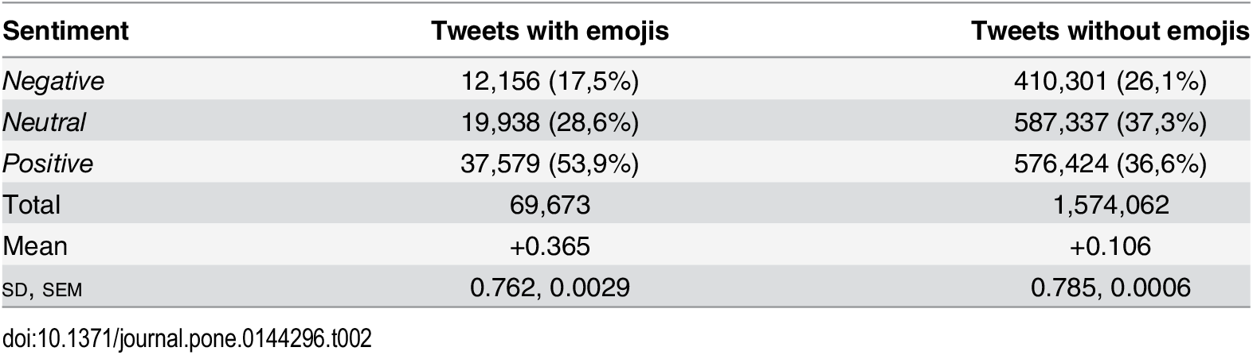
Tweets w/ vs w/o emojis

Slide 20
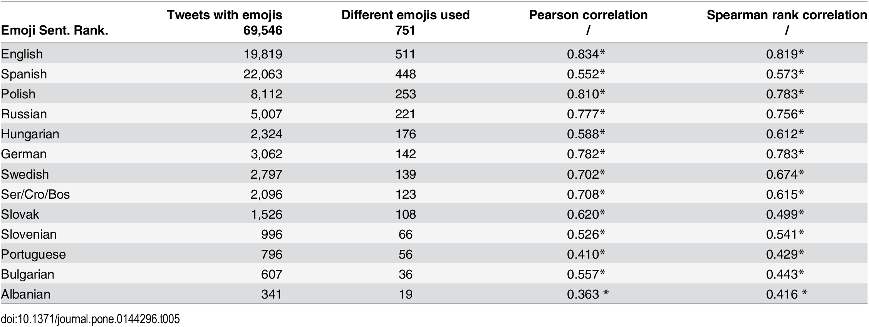
Tweets by Language

Slide 21
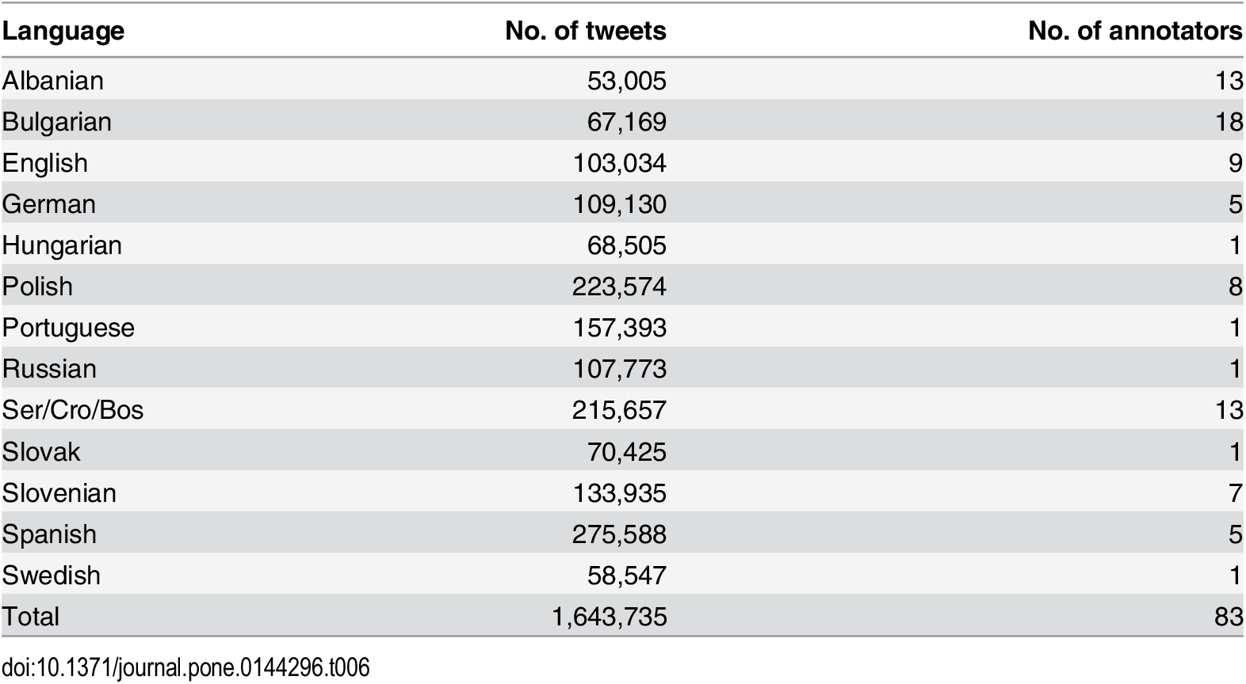
Annotator Information

Slide 22
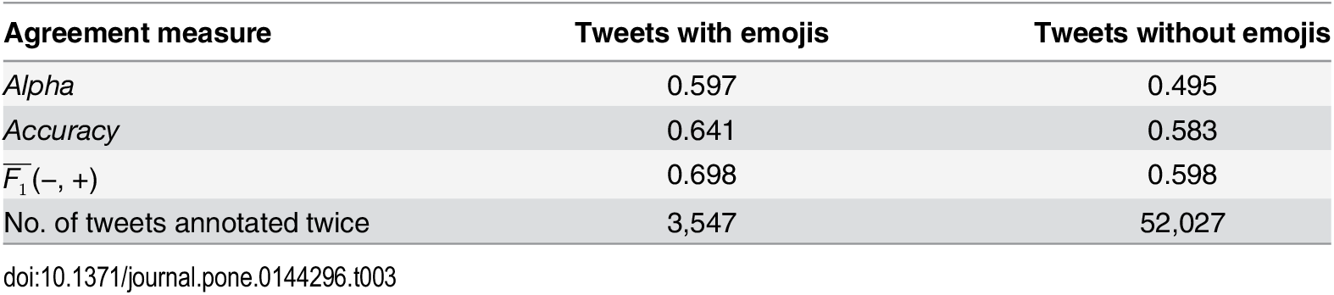
Agreement Measurement

Slide 23

Citation
Kralj Novak P, Smailović J, Sluban B, Mozetič I (2015) Sentiment of Emojis. PLoS ONE 10(12): e0144296. https://doi.org/10.1371/journal.pone.0144296

